Slide 1


ScyMotive
Cybersecurity. Intelligence. Trust.
ScyMotive is a European cybersecurity company focused on securing intelligent transportation, automotive systems, AI infrastructure, and national critical assets.
Our Why:
Security is not code.
It’s responsibility.
It’s people.
It’s life.
And we protect it.
ScyMotive-CSIRT 24/7 • incident@scymotive.com • Cyber Incident Emergency Response
Notes:
Theres animation video here…Please use presentation mode.

Slide 2
Industries We Secure
1. Transport & Logistics
– Fleet cyber defense, smart rail/metro, ports & airports
– Supply chain monitoring & telematics protection
2. Infrastructure: Production Lines, Hospitals, City, Schools
– OT/ICS security, smart cities (CCTV, IoT), energy & utilities
– Hospitals (AMR & medical networks), public sector & education
3. Automotive: OEMs & Tier‑1
– Secure SDV architecture & V2X security
– Embedded ECU security & cybersecurity by design
– ISO/SAE 21434 compliance
We refuse to accept a world where our families are exposed to cyber threats — so we are building one that isn’t.
ScyMotive-CSIRT 24/7 • incident@scymotive.com • Cyber Incident Emergency Response

Slide 3
Services & Experience
Core Services:
• Cybersecurity audits & pentesting (IT/OT, V2X, telematics)
• Threat intelligence & SOC monitoring
• Incident response & digital forensics
• Automotive cybersecurity & SDV security
• AI security & model protection
• EU NIS2 | ISO 27001 | ISO/SAE 21434 compliance
Experience Advantage:
• National security background – Ministry of Interior & Administration Poland MSWiA(critical infrastructure), 24/7
• Automotive security for EU/Asia OEM programs VW, Stellantis, Mercedes Benz, IVECO, Diamler Trucks (via Tier‑1 projects)
• Industrial OT security deployments
• ScyMotive‑CSIRT – 24/7 emergency cyber response
We believe actions speak louder than words…Let’s get started!
ScyMotive-CSIRT 24/7 • incident@scymotive.com • Cyber Incident Emergency Response

Slide 4
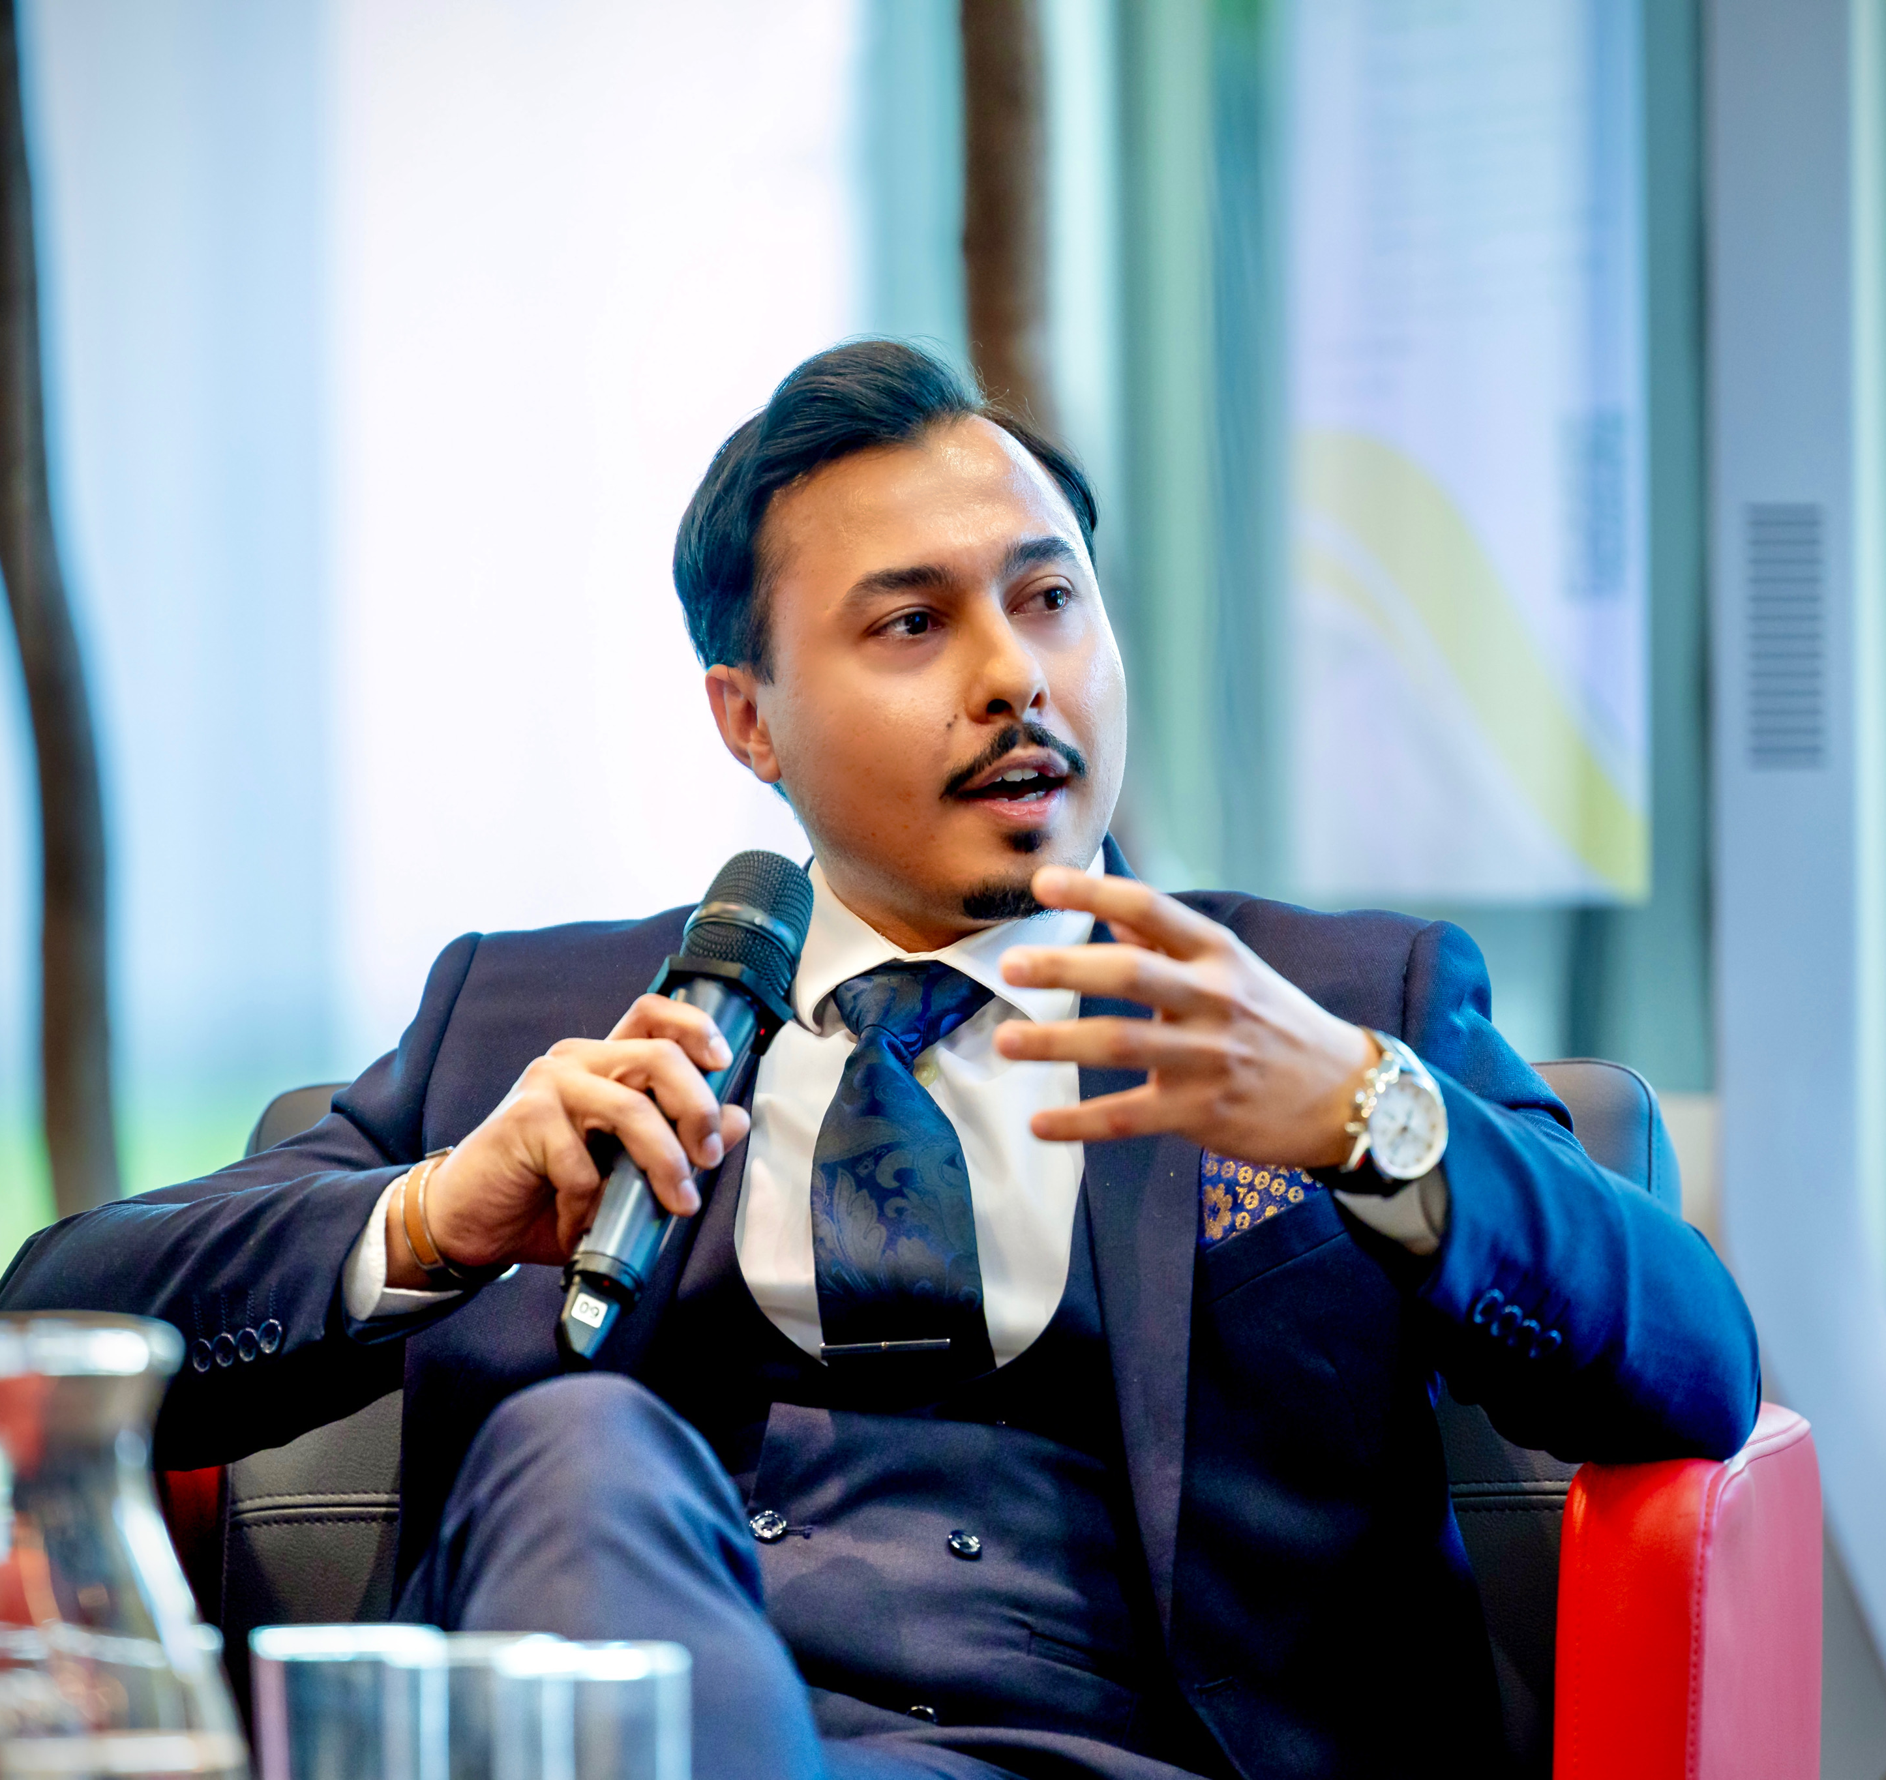
CEO| Founder ScyMotive Speaking at British Embassy Warsaw
Zeeshan Naeem
Father , Scientist, Leader
https://www.linkedin.com/in/zees4n/
Lodz, Poland

